Slide 1
Managing Object Creation
IN710 OOSD 2017
Session 5.2
Notes:
Demo game first

Slide 2
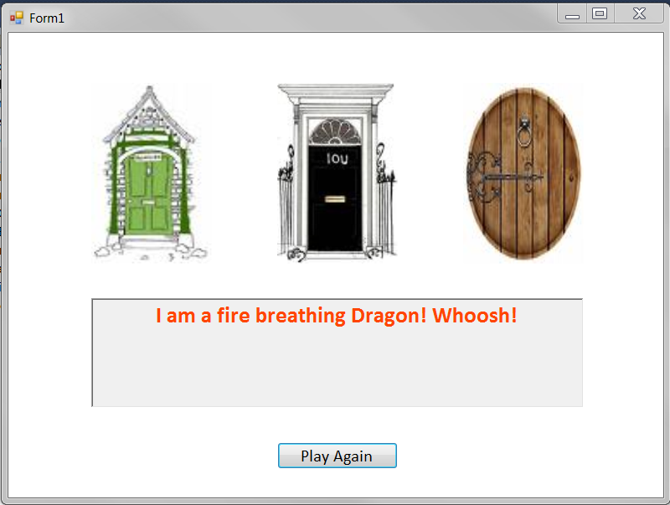
The Mystery Door Game
Notes:
This is a simple game
There are four kinds of characters – vampires, witches, dragons and golden geese
Game characters hold a string called ‘message’ to which is their behaviour (in place of an animation, say). For example, witches say ‘I am a witch! Cackle!’
They each have a text colour that they want their text message to be printed in (we use a richTextBox control for this).
There is a gameEngine class that holds a collection of these characters and a richTextBox for printing.
There is a Form class that provides the screen.
Characters are randomly allocated to doors (duplication is permitted).
The player clicks on a door, and the character behind it is revealed by the contents of the rtb.
The goal is to get the Goose.
We are going to look at the very simple code of this very simple game closely
We will be able to see a common sort of problem, and then learn the design pattern to fix it
We will start with the game characters

Slide 3
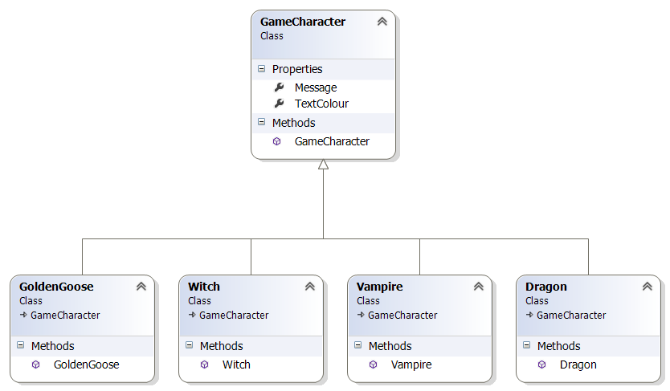
The Mystery Door Game
Notes:
So here is the game character class hierarchy...
In reality these classes are so simple we might not make this architecture, we’d just set the message string and text colour and get on with it. But we make these separate classes on the assumption that in a real game the characters would be complex things with some common data and methods and some need for polymorphism, as we have often seen.

Slide 4
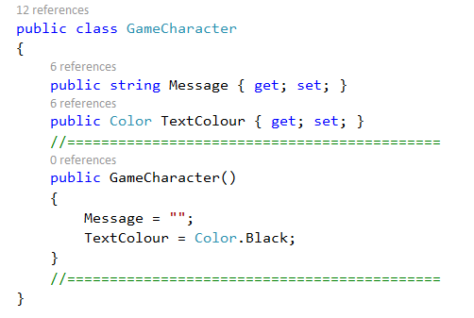
The Mystery Door Game
Notes:
Here is the base class
Again, in a real situation there would be lots of stuff going on here, but in this simple example, we’ll just pop some data in here.
I’ve chosen some sensible defaults here – you could have left it empty.
Note that the whole abstract/virtual discussion doesn’t apply to constructors. All children should have their own constructors, regardless. Sometimes all that happens is that they call the parent’s constructor (base) but they still have their own.
The game engine class will access the data and use it.

Slide 5
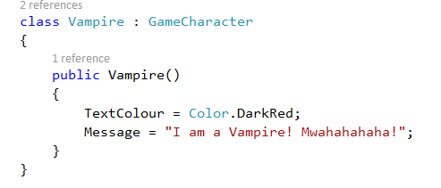
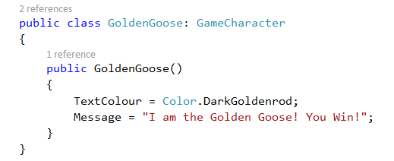
The Mystery Door Game
Notes:
And here are two of the concrete child classes
They only need to set up their class-specific data values in a constructor.
Again, the architecture is too heavy for the example – just imagine that there was lots of code in the base class for animation, path-finding, etc.
The others you can figure out

Slide 6
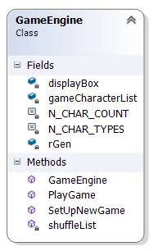
The Mystery Door Game
Notes:
Here is GameEngine
His job is to run the game and to keep the Form and the Characters uncoupled.
It would not be unreasonable in a real game to break this up into two classes, but we don’t want the example to get out of hand.
It has a List<GameCharacter>. A list of the base class can be filled with any child instances (remember cat and dog are both mammals).
A constant to tell it how many character types it can choose from and how many it needs (the number of doors)
A richTextBox to output the Character’s messages and apply their colours.
A random generator for random assignment and shuffling.
Methods: constructor, game setup, shuffle and game play

Slide 7
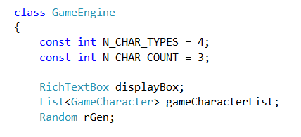
GameEngine Fields
Notes:
The start of the class, showing the class data fields

Slide 8
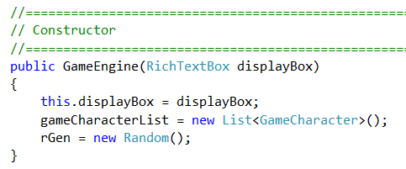
Game Engine Methods
Notes:
Constructor
We’re permitting some coupling here so that we can do this all in a single class because it fits better on one slide.
Recognise that it would be preferable to decouple the Game Engine from the Presentation layer.

Slide 9
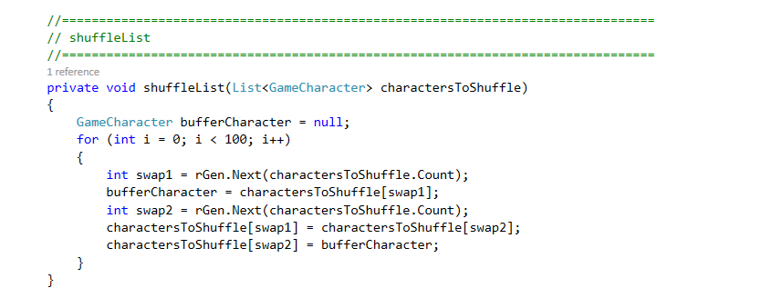
Game Engine Methods
Notes:
A simple shuffle algorithm…
We’ll look in a minute at how we put the characters into the list.

Slide 10
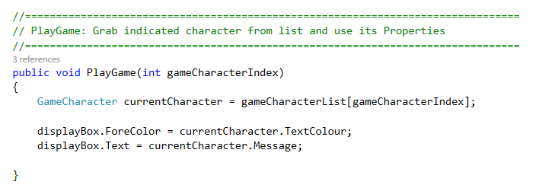
Game Engine Methods
Notes:
The PlayGame method…
The Form will pass in the index via the pictureBox onclick handlers. PictureBox1 calls PlayGame(0), PictureBox2 calls PlayGame(1)...
Grab the values and use them – access the character in the corresponding position and output appropriately to the rtb. (No logic for determining the win, but there could be some.)
Let’s just see what that looks like in the Form….

Slide 11
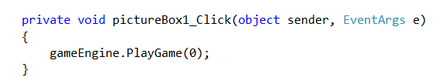
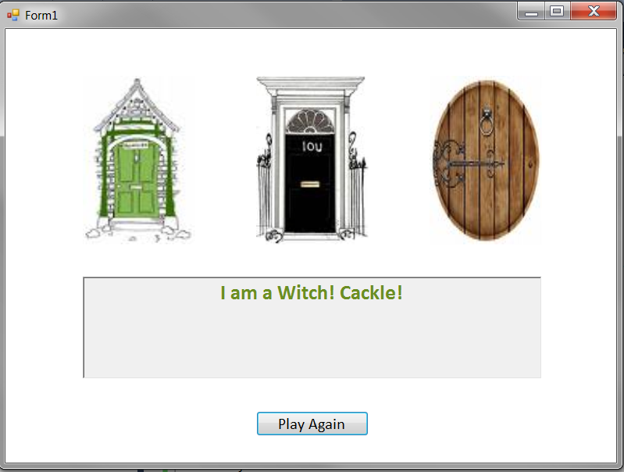
The Mystery Door Game
Notes:
So if you click on door1 (pictureBox1) this is the code that is executed.
If there is a witch “behind door 1”, (i.e. in the first position of the GameEngine’s character list), you see this.
All good so far?
So let’s look now carefully at the method where the problem arises.
This is the setUpGame method of GameEngine
It is called in Form_Load to start things, and it is called every time someone clicks the new game button

Slide 12
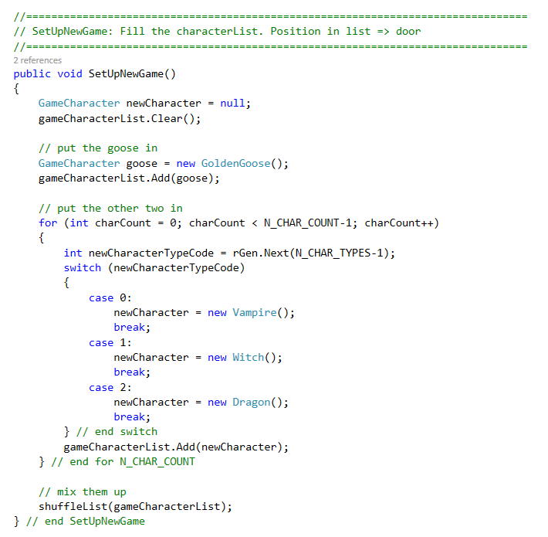
Game Engine Methods
Notes:
The method we are really interested in.
This method belongs to the GameEngine class
This is the method called to set up a new game
The main work here is to create new characters and add them to the list, for playGame() and shuffle() to use.
First, we put in the goose.
Then, for the other doors, it generates a random number, then uses that to decide what kind of game character to put behind the door. Given the OOAD principles we have been going on and on about so far, what is wrong with this code?
If you can’t see it, consider what would happen if we decided to add a new kind of game character, say a Unicorn.
We are making a change to the GameCharacter class hierarchy, but we will have to touch the code here (specifically, the switch statement) in the GameEngine class.
This is Bad, and arises because GameEngine and GameCharacter are coupled.
And in a real game, think about how many different points in the main game code you might need to create a new game character. Will you have a switch statement at every one of them? Will you modify all of them when you add a new character? Ew?
How can we modify our implementation so that we can freely add new game characters and not have to touch the GameEngine class?

Slide 13
Useful Rule
“Encapsulate what changes”
In our game, one thing that might change is the production of game characters.
GameEngine
coupled ☹
uses
Character Factory
creates
Game Characters
Notes:
This is a good guide for OO.
We want to be graceful under change
If we can identify the things that will change and encapsulate them, we can localise the impact.
We can protect other elements
In our game, what can change is the choice and production of game characters. So that is what we want to encapsulate
And what is the OO way to encapsulate something?
Make it a class
This kind of class is called a ‘factory’.
Its sole responsibility is to produce objects according to some rule, and return them
It’s kind of like a constructor machine.
Let’s look at the code for the character factory...

Slide 14
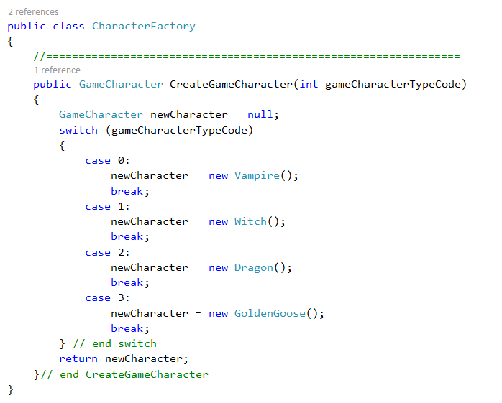
CharacterFactory
Notes:
It only has one method....(plus an empty constructor for completeness, not shown here.)
We have taken the code that is sensitive to change (the switch statement used to create a new character) and we have removed it from GameEngine and placed it in its own class
So what happens to GameEngine.SetUpGame()……?

Slide 15
Old GameEngine Code
Notes:
Before…

Slide 16
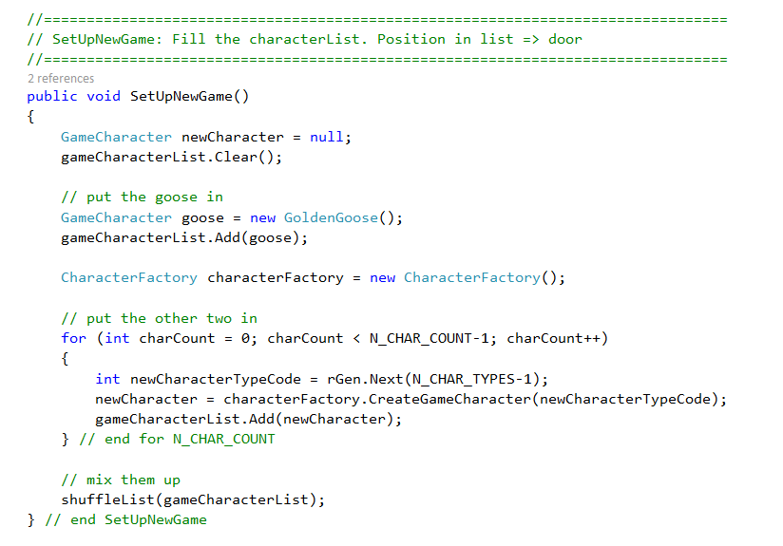
New GameEngine Code
Notes:
GameEngine code now..
Note that we could have created the factory in the constructor.
I just put it here so you could see it being created...
Now isn’t this nice code?
What happens to GameEngine if you need to add unicorns? NOTHING (except updating the N_CHAR_TYPES constant, which isn’t architectural – IRL would probably be read in from some config file, so no code would change).
Only the factory class changes.
In fact, the GameEngine doesn’t know anything about the actual product it uses.
If you wanted to change the game so that there were bunny rabbits, or space alien vehicles or quotes from Shakespeare behind the doors, it wouldn’t make any difference at all. ⬅ Yay!!!
Compare how much knowledge GameEngine has about the Character family in the before and after versions. Knowledge = coupling. Coupling = brittle code.

Slide 17
Question that’s Bothering You
“But aren’t the GameCharacter classes and the CharacterFactory class coupled?”
Notes:
Isn’t the factory now violating the Open/Closed principle?
The answer is yes.
But it is basically the GameFactory’s job (SRP) to be coupled to the GameCharacter hierarchy.
As opposed to the GameEngine class, who has a different responsibility (managing the game data and logic).
The CharacterFactory encapsulates the necessary coupling, isolating GameEngine from it.
You won’t break other functionality in CharacterFactory, because there isn’t any.
And the coupling is localised to one place in the system, not spread around to every location that you need to create a character.

Slide 18
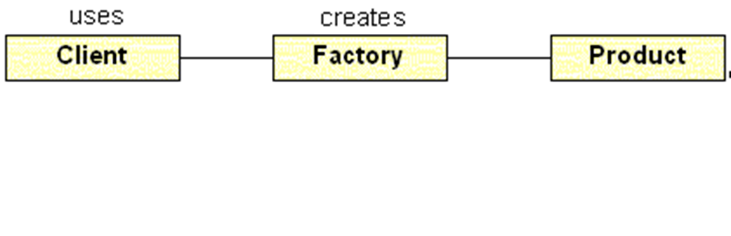
The Simple Factory
“Decoupling object use and creation by delegating the creation process to a dedicated class.”
Notes:
The technique we have just seen is called the simple factory pattern
If you ever have a class method that contains logic to create one of a number of other class instances, you should consider encapsulating that logic into its own class (a Factory).
Then, instead of peppering that logic all over the place in the consumer class, it resides only in the Factory, and the consumer class simply talks to the Factory object as needed.
Although quite useful, it is not one of the official 23 GoF patterns.
The GoF contains a number of more complex factory-based patterns, and we will see the most important one next.

Slide 19
Main Theoretical Point
Decoupling object creation from object use is a powerful technique that supports code flexibility and reuse.
Notes:
Need practical

Slide 20
Practical
On the I drive is a Project called SimpleFactoryPrac.
It involves object creation...done wrong.
Figure out what SimpleFactoryPrac does, and refactor it to correctly use a Simple Factory Pattern.
Notes:
We will see a more complex Factory pattern next week.
For now, here is your practical.
Decoupling object creation is the job. Think about what that means for this specific application. Your solution may need to be a variation on the one shown in the ppt.
Please note the early due date. This is quite an easy prac, so please make sure to get it done on time.

Slide 21
Practical
Think carefully...
...about the data each class needs. When you remove functionality from a class, you often also change its data needs. Don’t give a class data it doesn’t need.
...about the function of Simple Factory. Not all Simple Factories have exactly the same structure, but they all perform the same job.
Please finish by Friday at 5.00.
Notes:
Having data you don’t need is an unnecessary dependency. Avoid.
Decoupling object creation is the job. Think about what that means for this specific application. Your solution may need to be a variation on the one shown in the ppt.
Please note the early due date. This is quite an easy prac, so please make sure to get it done on time.

